Slide 1
k-mer algorithms for microbiome classification of metagenomic data

Slide 2
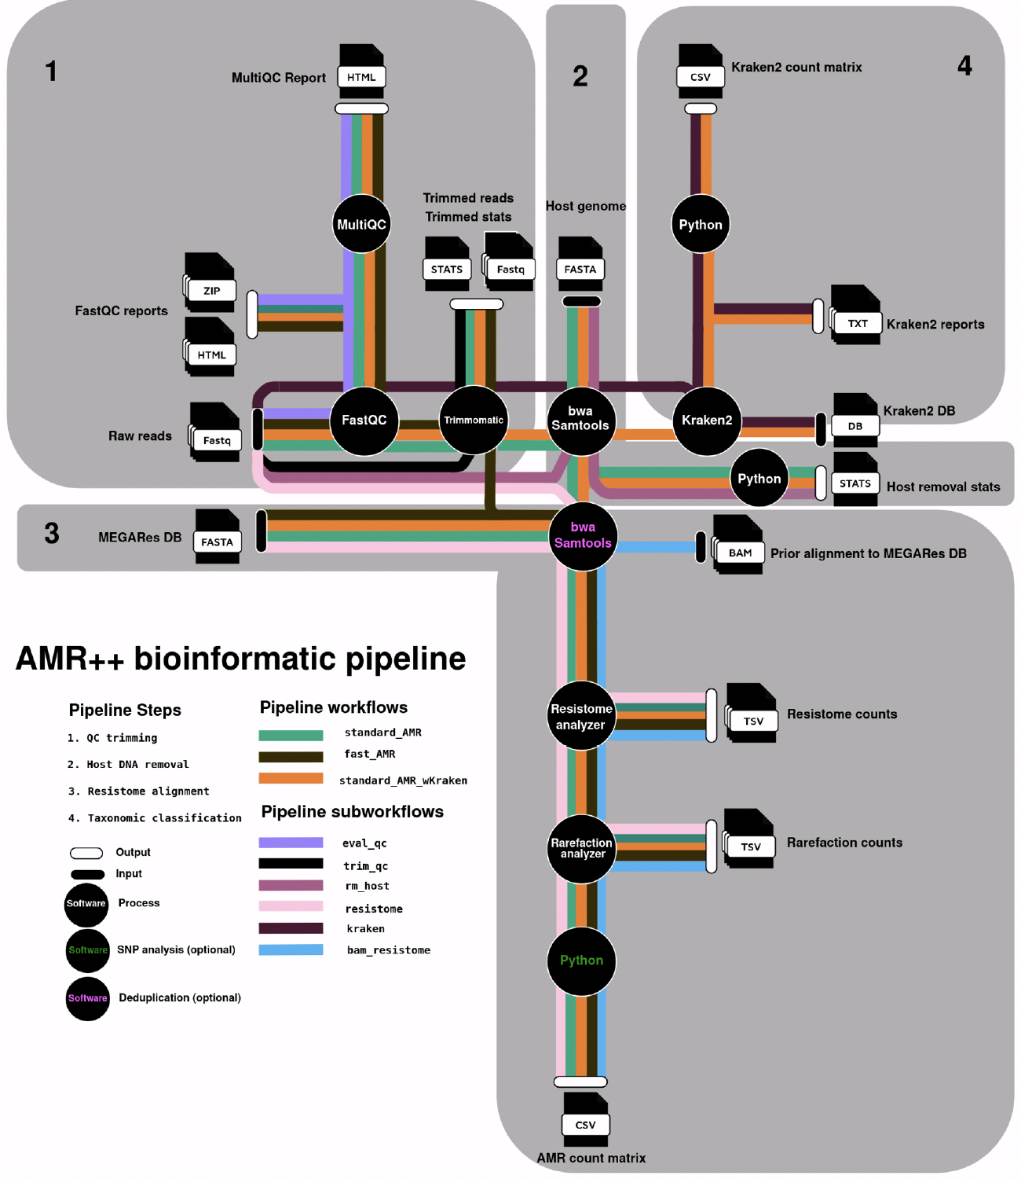
Notes:
- So how do we actually correct for Illumina systemic bias?
- We do this with read trimming, which is done as the first step in the AMR++ pipeline.

Slide 3
Let’s assume that we want to create a simple microbiome profile for 1 sample

Slide 4
Let’s assume that we want to create a simple microbiome profile for 1 sample
Basically, we want to know:
WHO is there?
What is their RELATIVE ABUNDANCE?

Slide 5
Let’s start with WHO is there…

Slide 6
2 approaches for determining who is there:
Marker-based
Genome-based

Slide 7
Marker-based methods = “16S on steroids”
Examples:
MetaPhlAn
PhyloSift

Slide 8
2 approaches for determining who is there:
Marker-based
Genome-based

Slide 9
Genome-based = you are trying to use all of the sequence data to identify taxa

Slide 10
Genome-based = you are trying to use all of the sequence data to identify taxa
Historically, an alignment- or assembly- and blast-based approach was used

Slide 11
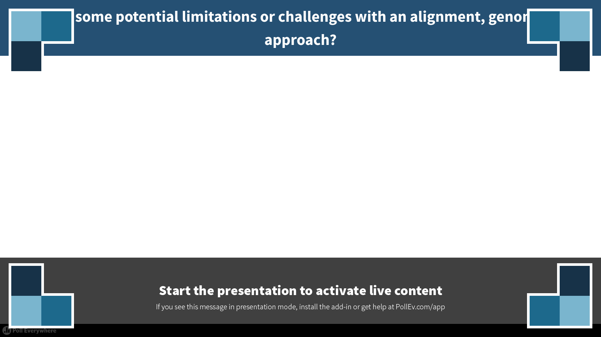
Notes:
What are some potential limitations or challenges with an alignment, genome-based approach?
https://www.polleverywhere.com/free_text_polls/62MTTMeK9S61jHv

Slide 12
Genome-based = you are trying to use all of the sequence data to identify taxa
Major problems that people are trying to solve:
Computational burden
Sequence homology (who is it really?)
Solutions are referred to as “compositional-based”

Slide 13
How could the metagenome composition be used to bin and classify sequence data?
GC-content, nucleotide frequencies, codon patterns
k-mer based
exact-match
profile

Slide 14
Today, we will focus on kraken, an exact-match k-mer method (which has performed well in several methods papers)

Slide 15
What is a k-mer?
A DNA sequence of length k
k is an integer of minimum length 1
2-mers: AG, GC, GG, CC, AA
3-mers: ACT, GCT, CCC, TTT
4-mers: ACGT, AAAA, TTTT
k-mers are often smaller “words” within a longer strand of DNA, can be overlapping
DNA read: ACGTGTGTTTCCCAATCG
Some 4-mers within this read: ACGT, CGTG, TGTG, TTTC

Slide 16
Each Sequence has a k-mer Profile
For every sequence, there exists a profile of k-mers
Sequence: ACGTGTG
3-mer profile:
ACG: 1
CGT: 1
GTG: 2
TGT: 1
2-mer profile:
AC: 1
CG: 1
GT: 2
TG: 2

Slide 17
K-mer Profiles Contain Information
k-mer profiles can help to identify a sequence
Match the k-mer profile of unknown sequences to known k-mer profiles
For example, the k-mer profiles of metagenomic sequence data to the k-mer profiles of RefSeq genomes!
This is a classification problem:
We have an unknown observed sequence
We have known genomes
We can use matching of k-mer profiles to label the unknown sequence

Slide 18
First, we have to create a k-mer profile of the known genome sequences!
This is kraken’s “database”; it is a database of k-mer profiles created from NCBI RefSeq genomes, which are also linked to NCBI’s taxonomy
kraken-build command
This database is large, and it requires a lot of computational resources to build it; however, once it is built, it can “sit” on your computer to be used over and over again
can also be updated periodically

Slide 19
At the heart of kraken is its database. How is it created (high level)?
Chop up all of the genomes in RefSeq
Compare all of the pieces to one another
Pieces without a match represent the RefSeq genome ”as-is” (strain, species, genus, etc….)
Pieces with match(es) get moved up the taxonomy until they are unique within a “level” (the “lowest common ancestor” or LCA approach)

Slide 20
Let’s do an example….
After chopping up all RefSeq genomes into 4-mers, we have identified that the 4-mers ACCT and GGTA are contained within these genomes, and we want to uniquely associate them with taxa in the NCBI taxonomy.

Slide 21
Kingdom
Phylum
Class
Order
Family
Which species is it?
Genus
✓
ACCT
ACCT
ACCT
GGTA
Species
Salmonella enterica ssp. arizonae
Salmonella enterica ssp. enterica
Salmonella bongori
Escherichia coli

Slide 22
Kingdom
Phylum
Class
Order
Family
How could we resolve this?
Genus
ACCT
ACCT
ACCT
Species
Salmonella enterica ssp. arizonae
Salmonella enterica ssp. enterica
Salmonella bongori

Slide 23
Kingdom
Phylum
Class
Order
Family
ACCT
ACCT
ACCT
Genus
Salmonella
Salmonella
Salmonella
Species

Slide 24
Kingdom
Phylum
Class
Order
Uh-oh…..
Family
ACCT
ACCT
ACCT
ACCT
Genus
Salmonella
Salmonella
Salmonella
Yersinia
Species

Slide 25
Kingdom
Phylum
Class
Order
ACCT
ACCT
ACCT
ACCT
Family
Enterobacteriaceae
Enterobacteriaceae
Enterobacteriaceae
Enterobacteriaceae
Genus
Species

Slide 26
What do you end up with? The database…
K-mer sequence
NCBI taxonomic ID
kraken ID
ACCT
Enterobacteriaceae
1339265
GGTA
Escherichia coli
3927561

Slide 27
How do we use this database to classify the reads in our metagenomic data?
K-mer sequence
NCBI taxonomic ID
kraken ID
ACCT
Enterobacteriaceae
1339265
GGTA
Escherichia coli
3927561

Slide 28
When you then run your sequence data through kraken, it looks for exact k-mer matches
K-mer sequence
NCBI taxonomic ID
kraken ID
ACCT
Enterobacteriaceae
1339265
GGTA
Escherichia coli
3927561
Your Fastq:
HiSeq2000:123456
ACCT
+
#!%&
HiSeq2000:123457
GGTA
+
HHII

Slide 29
When you then run your sequence data through kraken, it looks for k-mer matches
K-mer sequence
NCBI taxonomic ID
kraken ID
ACCT
Enterobacteriaceae
1339265
GGTA
Escherichia coli
3927561
Your Fastq:
HiSeq2000:123456
ACCT
+
#!%&
HiSeq2000:123457
GGTA
+
HHII
1 count for Enterobacteriaceae
1 count for Escherichia coli

Slide 30
But sometimes it is messy….

Slide 31
But sometimes, it is messy…
Kraken’s default k-mer size for the exact-matching process is 31
Kraken takes every 31-mer from every read and attempts to match it (exactly!) to the kraken database
Some 31-mers don’t match (exactly) to anything = unclassified
A single read is usually 150-300bp, and therefore it contains many 31-mers. Sometimes, those 31-mers match to different things. In that case…there is a confidence scoring system.

Slide 32
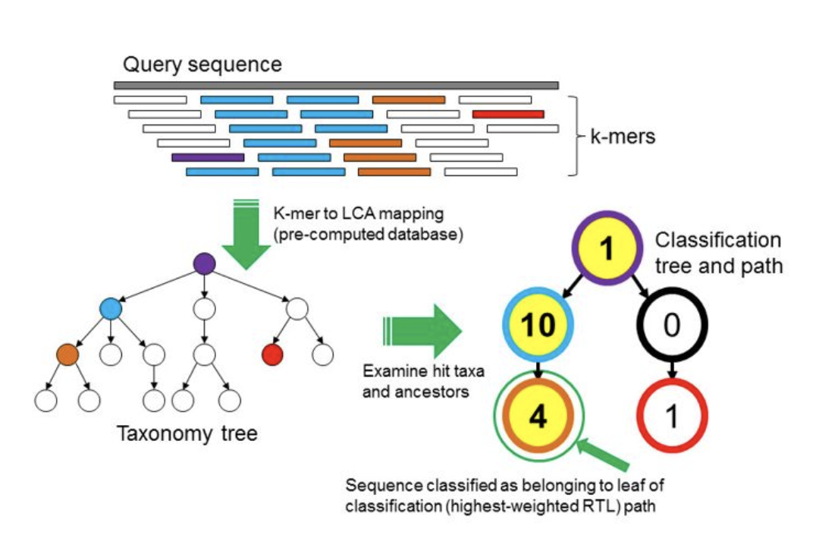
Root-to-Leaf classification process:
Source: Figure 1 of kraken paper (https://doi.org/10.1186/gb-2014-15-3-r46)

Slide 33
Root-to-Leaf classification process:
Source: Figure 1 of kraken paper (https://doi.org/10.1186/gb-2014-15-3-r46)

Slide 34
Root-to-Leaf classification process:
Source: Figure 1 of kraken paper (https://doi.org/10.1186/gb-2014-15-3-r46)

Slide 35
This RTL weighting is a very important parameter within kraken!!
It is controlled via the “-c” option (more on this later)

Slide 36
Benefits and Limitations (some)
The Good:
Rapid
High specificity (**caveat: for those organisms in the RefSeq database)
Pulls from a relatively well-curated database (**caveat: plasmids)
The Bad:
High rate of “unclassified”
Varying “degrees” of taxonomic resolution (and probably non-random)
Pulls from a relatively small database

Slide 37
Notes:
- So how do we actually correct for Illumina systemic bias?
- We do this with read trimming, which is done as the first step in the AMR++ pipeline.

Slide 38
Questions???

Slide 39
More details (from user manual):
OUTPUT: "562:13 561:4 A:31 0:1 562:3" would indicate that:
the first 13 k-mers mapped to taxonomy ID #562
the next 4 k-mers mapped to taxonomy ID #561
the next 31 k-mers contained an ambiguous nucleotide
the next k-mer was not in the database
the last 3 k-mers mapped to taxonomy ID #562
In this case, ID #561 is the parent node of #562. Here, a label of #562 for this sequence would have a score of C/Q = (13+3)/(13+4+1+3) = 16/21. A label of #561 would have a score of C/Q = (13+4+3)/(13+4+1+3) = 20/21. If a user specified a confidence threshold over 16/21, the classifier would adjust the original label from #562 to #561; if the threshold was greater than 20/21, the sequence would become unclassified.

